Slide 1


Maheshkumar Pillai
06/25/2023

Slide 2

Outline
Executive Summary
Introduction
Methodology
Results
Conclusion
Appendix

Slide 3
Executive Summary
Summary of methodologies
Data Collection through API
Data Collection with Web Scraping
Data Wrangling
Exploratory Data Analysis with SQL
Exploratory Data Analysis with Data Visualization
Interactive Visual Analytics with Folium
Machine Learning Prediction
Summary of all results
Exploratory Data Analysis result
Interactive analytics in screenshots
Predictive Analytics result

Slide 4
Introduction
Project background and context
Space X advertises Falcon 9 rocket launches on its website with a cost of 62 million dollars; other providers cost upward of 165 million dollars each, much of the savings is because Space X can reuse the first stage. Therefore, if we can determine if the first stage will land, we can determine the cost of a launch. This information can be used if an alternate company wants to bid against Space X for a rocket launch. The project aims to create a machine-learning pipeline to predict if the first stage will land successfully.
Problems you want to find answers
What factors determine if the rocket will land successfully?
The interaction amongst various features that determine the success rate of a successful landing.
What operating conditions need to be in place to ensure a successful landing program?

Slide 5

Section 1

Slide 6
Methodology
Executive Summary
Data collection methodology:
Data was collected using SpaceX API and Web Scraping from Wikipedia.
Perform data wrangling
One-hot encoding was applied to categorical features
Perform exploratory data analysis (EDA) using visualization and SQL
Perform interactive visual analytics using Folium and Plotly Dash
Perform predictive analysis using classification models
How to build, tune, and evaluate classification models

Slide 7
Data Collection
Describe how data sets were collected.
Data collection was done using get request to the SpaceX API.
Next, the response was decoded as a JSON and turn it into a pandas data frame.
The data was cleaned, checked for missing values, and filled in missing values where necessary.
In addition, we performed web scraping from Wikipedia for Falcon 9 launch records with BeautifulSoup.
The objective was to extract the launch records as an HTML table, parse the table and convert it to a pandas data frame for future analysis.

Slide 8
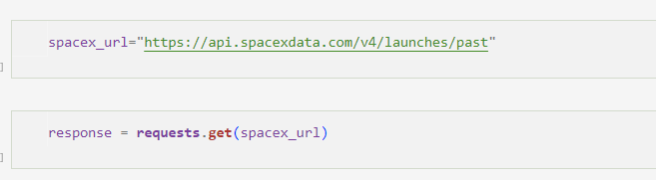
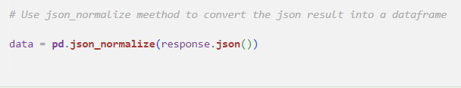
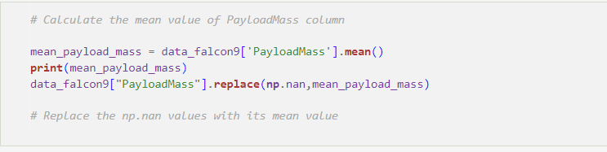
Data Collection – SpaceX API
We used the get request to the SpaceX API to collect data, clean the requested data, and did some basic data wrangling and formatting.
GitHub URL - https://github.com/Mahesh1596/IBM-Data-Science-Capstone-Project/blob/main/jupyter-labs-spacex-data-collection-api.ipynb

Slide 9
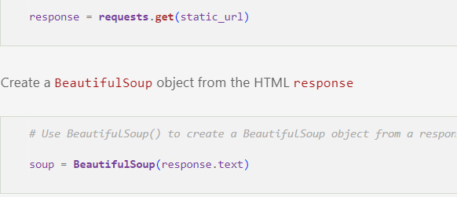
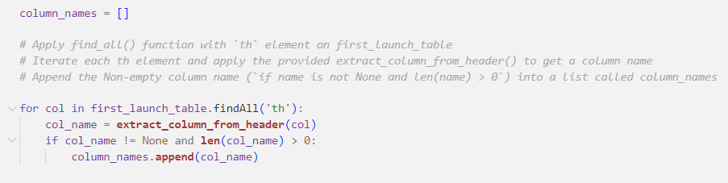
Data Collection - Scraping
Present your web scraping process using key phrases and flowcharts
GitHub URL - https://github.com/Mahesh1596/IBM-Data-Science-Capstone-Project/blob/main/jupyter-labs-webscraping.ipynb

Slide 10
Data Wrangling
We performed exploratory data analysis and determined the training labels.
We calculated the number of launches at each site, and the number and occurrence of each orbit
We created a landing outcome label from the outcome column and exported the results to CSV.
GitHub Link - https://github.com/Mahesh1596/IBM-Data-Science-Capstone-Project/blob/main/labs-jupyter-spacex-Data%20wrangling.ipynb

Slide 11
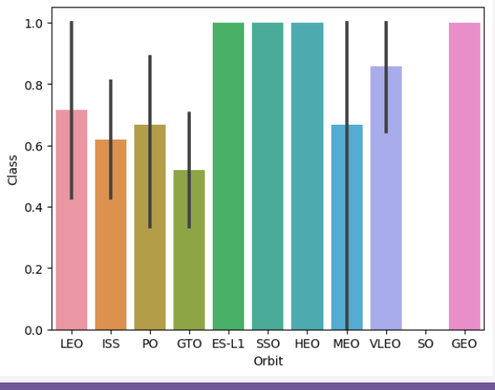
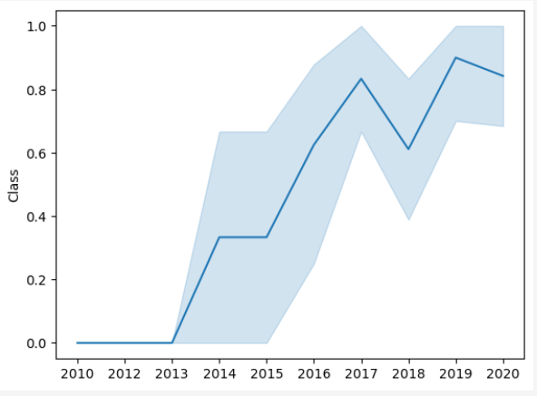
EDA with Data Visualization
We explored the data by visualizing the relationship between flight number and launch Site, payload and launch site, the success rate of each orbit type, flight number, and orbit type, and the launch success yearly trend.
GitHub URL –

Slide 12
EDA with SQL
We loaded the SpaceX dataset into a PostgreSQL database without leaving the Jupyter Notebook.
We applied EDA with SQL to get insight from the data. We wrote queries to find out for instance:
The names of unique launch sites in the space mission.
The total payload mass carried by boosters launched by NASA (CRS)
The average payload mass carried by booster version F9 v1.1
The total number of successful and failed mission outcomes
The failed landing outcomes in drone ship, their booster version, and launch site names.
GitHub URL - https://github.com/Mahesh1596/IBM-Data-Science-Capstone-Project/blob/main/jupyter-labs-eda-sql-coursera_sqllite.ipynb

Slide 13
Build an Interactive Map with Folium
We marked all launch sites and added map objects such as markers, circles, and lines to mark the success or failure of launches for each site on the folium map.
We assigned the feature launch outcomes (failure or success) to classes 0 and 1. i.e., 0 for failure, and 1 for success.
Using the color-labeled marker clusters, we identified which launch sites have relatively high success rates.
We calculated the distances between a launch site to its proximities. We answered some questions for instance:
Are launch sites near railways, highways, and coastlines?
Do launch sites keep a certain distance away from cities?
GitHub URL - https://github.com/Mahesh1596/IBM-Data-Science-Capstone-Project/blob/main/jupyter-labs-eda-dataviz.ipynb

Slide 14
Build a Dashboard with Plotly Dash
We built an interactive dashboard with Plotly dash
We plotted pie charts showing the total launches by a certain sites
We plotted scatter graph showing the relationship with Outcome and Payload Mass (Kg) for the different booster version.
GitHub URL - https://github.com/Mahesh1596/IBM-Data-Science-Capstone-Project/blob/main/spacex_dash_app.py

Slide 15
Predictive Analysis (Classification)
We loaded the data using numpy and pandas, transformed the data, and split our data into training and testing.
We built different machine-learning models and tune different hyperparameters using GridSearchCV.
We used accuracy as the metric for our model and improved the model using feature engineering and algorithm tuning.
We found the best-performing classification model.
GitHub URL - https://github.com/Mahesh1596/IBM-Data-Science-Capstone-Project/blob/main/SpaceX_Machine_Learning_Prediction_Part_5.jupyterlite.ipynb

Slide 16
Results
Exploratory data analysis results
Interactive analytics demo in screenshots
Predictive analysis results

Slide 17

Section 2

Slide 18
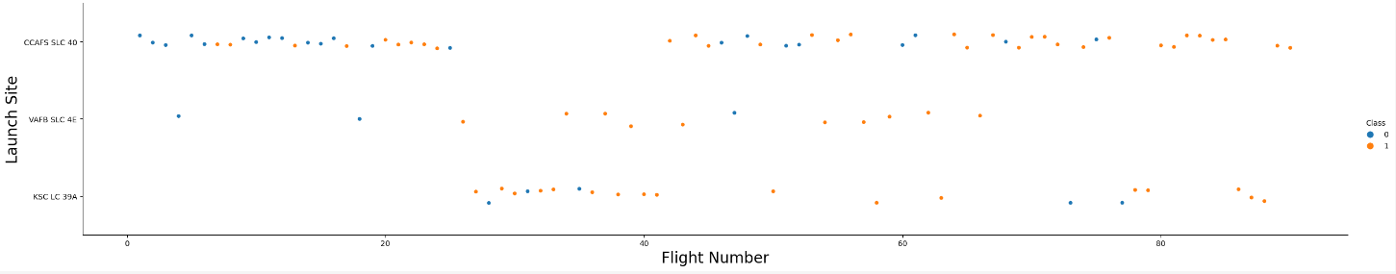
Flight Number vs. Launch Site
Flight Number vs. Launch Site
Success increases at Launch Site CCAFS SLC 40

Slide 19
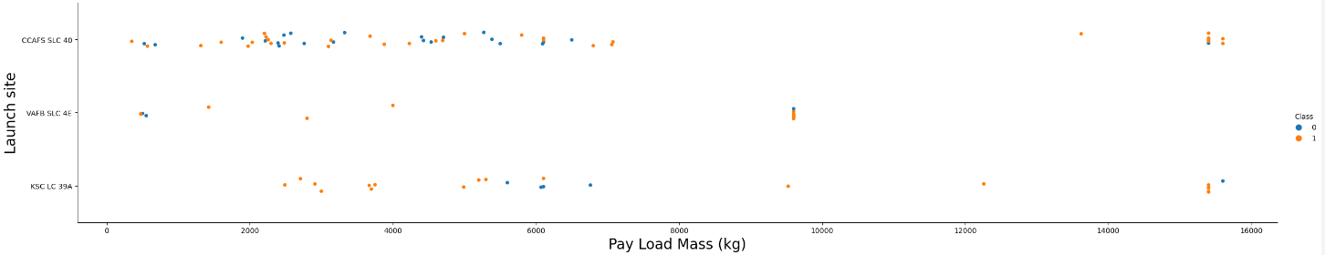
Payload vs. Launch Site
Payload vs. Launch Site
For the VAFB-SLC launch site there are no rockets launched for heavy payload mass(greater than 10000). The success rate is higher at Launch Site CCAFS SLC 40 for Pay Load less than 8000 Kg.

Slide 20
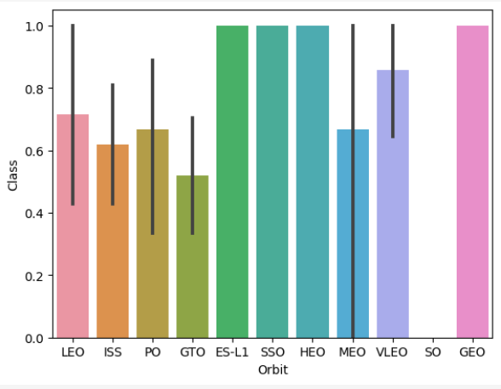
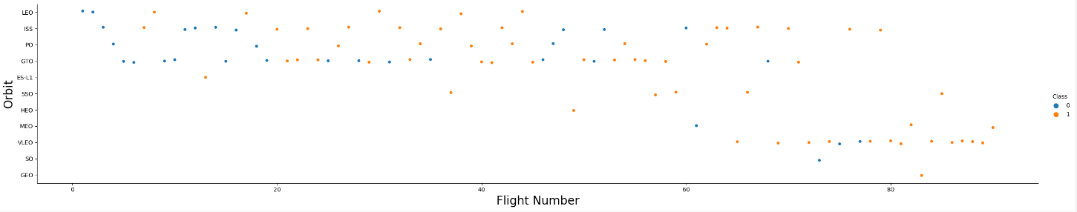
Success Rate vs. Orbit Type
From the plot, we can see that ES-L1, GEO, HEO, SSO, and VLEO had the most success rate.

Slide 21
Flight Number vs. Orbit Type
The plot below shows the Flight Number vs. Orbit type. We observe that in the LEO orbit, success is related to the number of flights whereas in the GTO orbit, there is no relationship between flight number and the orbit.

Slide 22
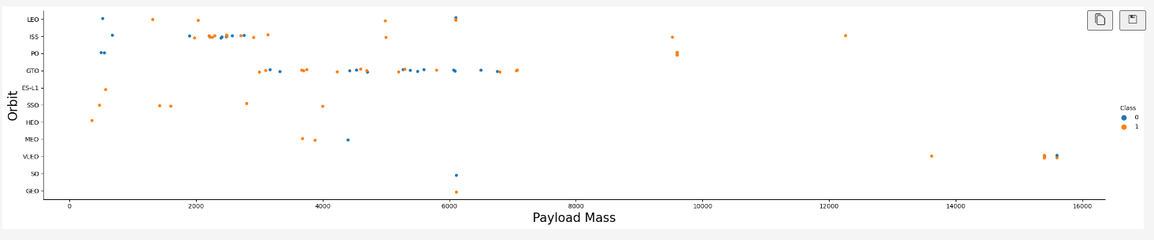
Payload vs. Orbit Type
Success rate is higher for payloads between 2000 and 6000 kg. With heavy payloads, the successful landing or positive landing rate is more for Polar, LEO, and ISS.
However, for GTO we cannot distinguish this well as both positive landing rate and negative landing(unsuccessful mission) are there.

Slide 23
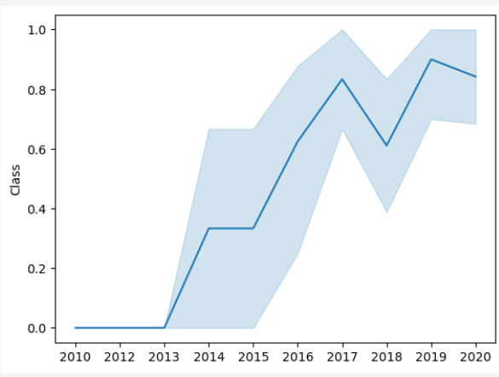
Launch Success Yearly Trend
Since 2013, the success rate has been on a consistent rise except for 2018.

Slide 24
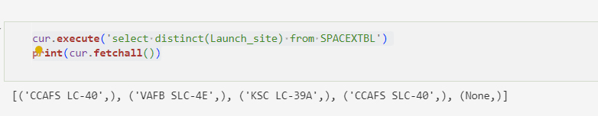
All Launch Site Names
Used DISTINCT keyword to extract the launch site names

Slide 25
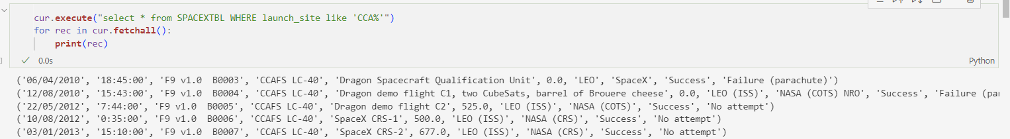
Launch Site Names Begin with 'CCA'
Used a simple “Select *” to extract all details for Launch Site starting like ‘CCA’

Slide 26
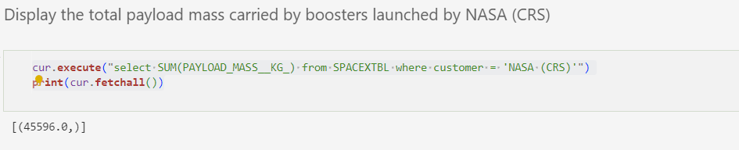
Total Payload Mass

Slide 27
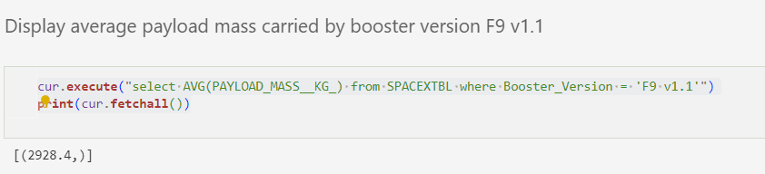
Average Payload Mass by F9 v1.1
Used the AVG aggregate function to calculate average payload mass

Slide 28
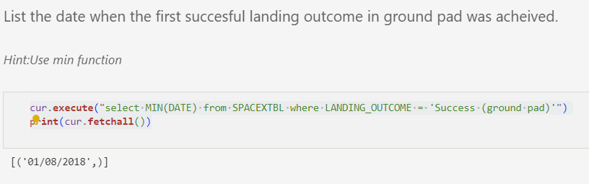
First Successful Ground Landing Date

Slide 29
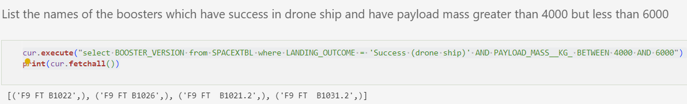
Successful Drone Ship Landing with Payload between 4000 and 6000

Slide 30
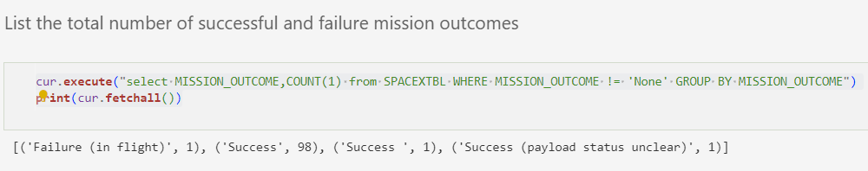
Total Number of Successful and Failure Mission Outcomes

Slide 31
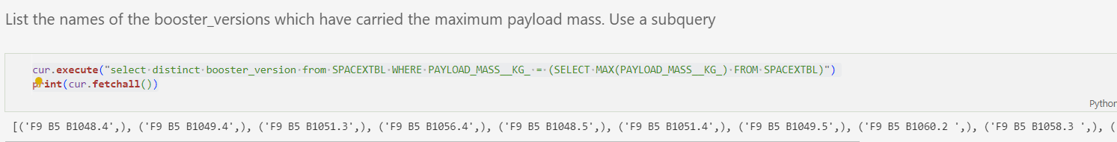
Boosters Carried Maximum Payload

Slide 32
2015 Launch Records

Slide 33
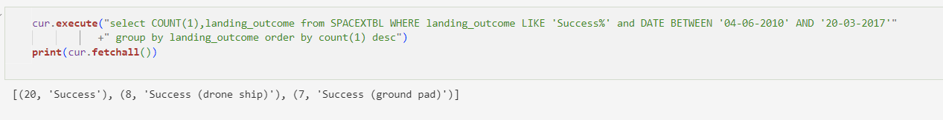
Rank Landing Outcomes Between 2010-06-04 and 2017-03-20

Slide 34

Section 3

Slide 35
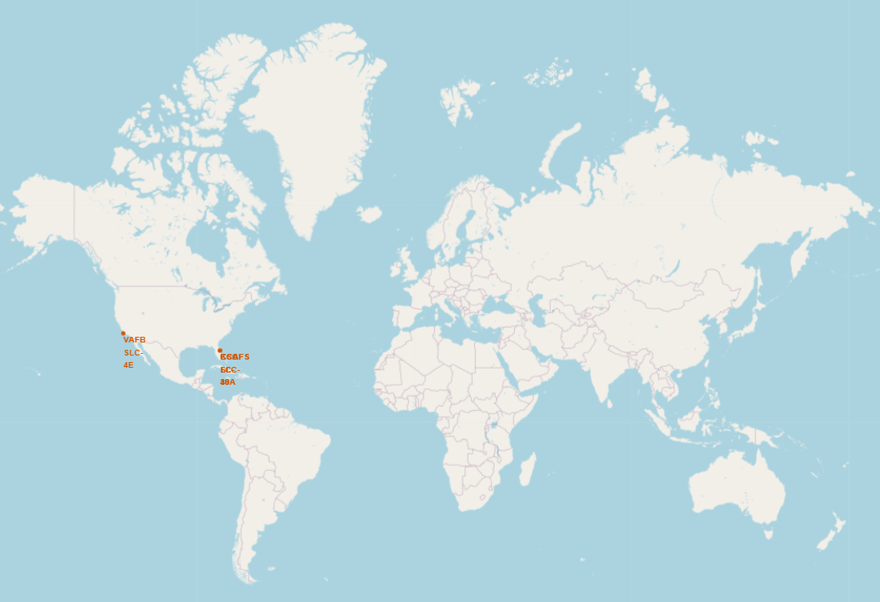
Space X Launch Sites Global Marker
All Launch Sites are on the coasts – Florida and California

Slide 36
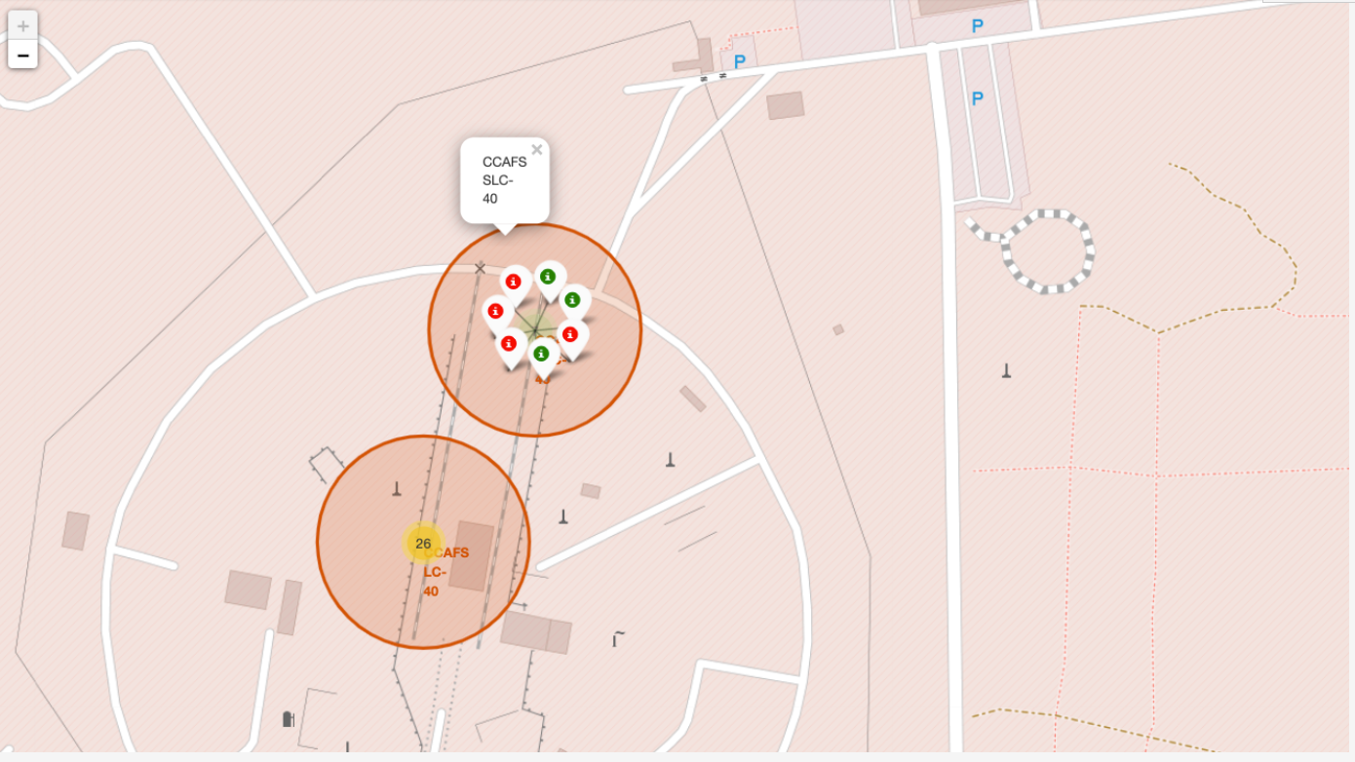
Launch Outcomes

Slide 37
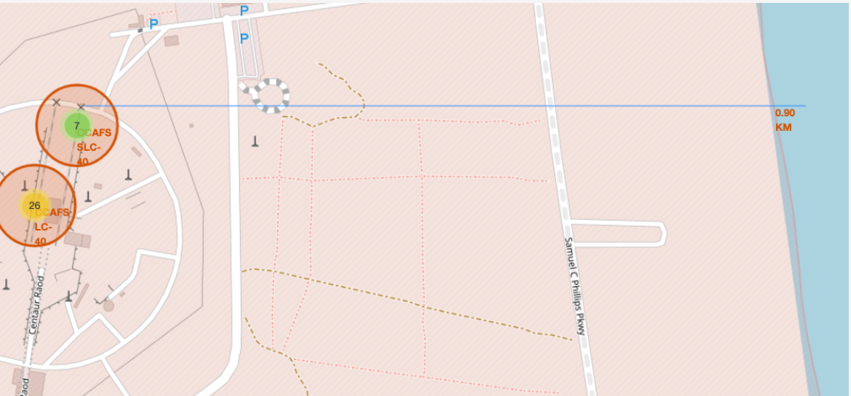
Launch Site distance to landmarks

Slide 38

Section 4

Slide 39
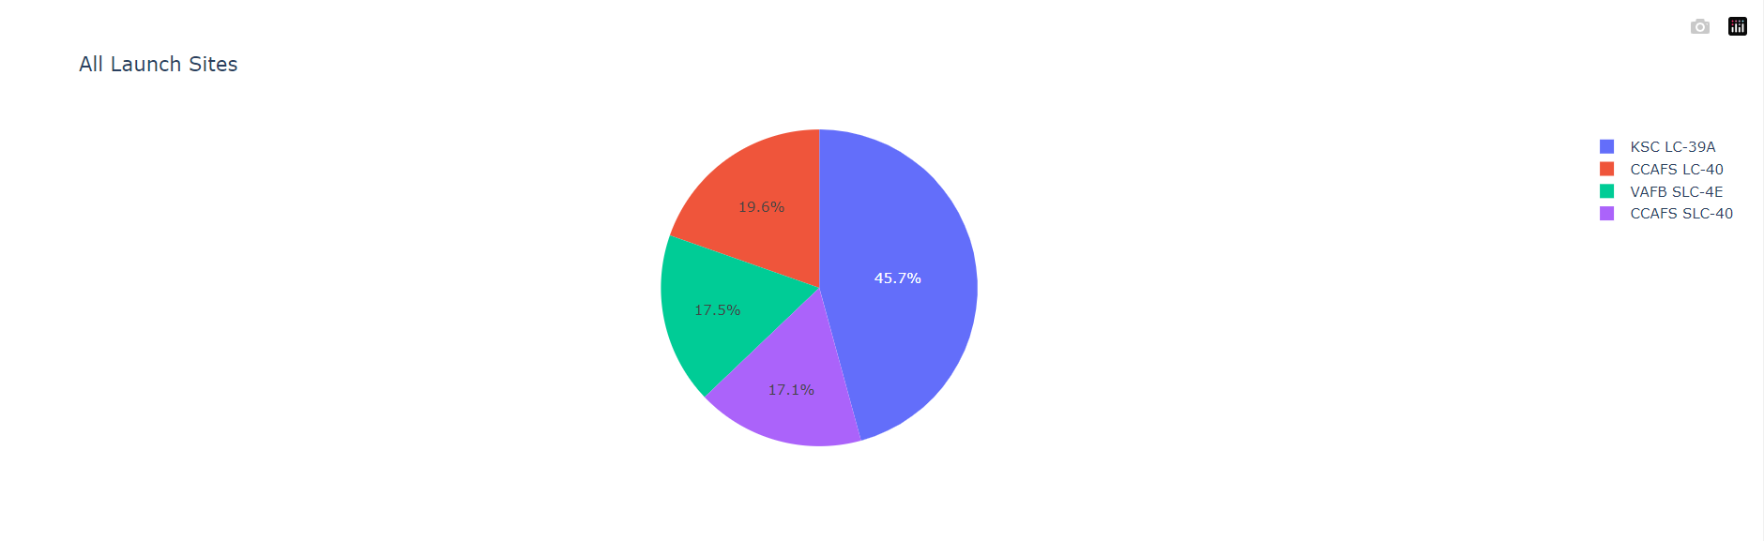
Success Pie – All Sites
KSC LC-39A is the most successful and CCAFS SLC-40 the least.

Slide 40

High Success Ratio
KSC LC-39A has the highest success to failure ratio

Slide 41

Launch Outcome v/s Payload
Low-weight payload rockets have had higher successful launch chances.

Slide 42

Section 5

Slide 43
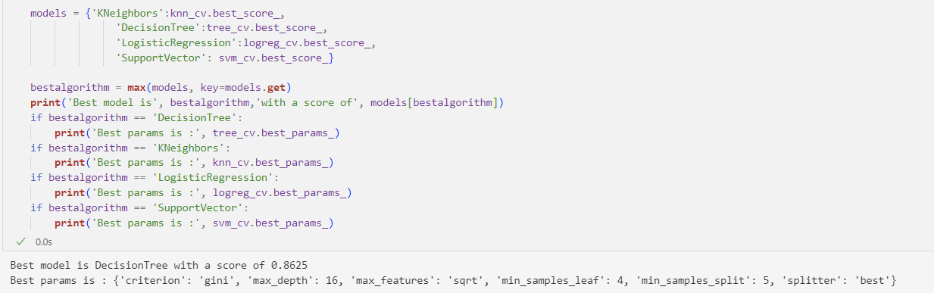
Classification Accuracy
The best model is Decision Tree Classifier

Slide 44
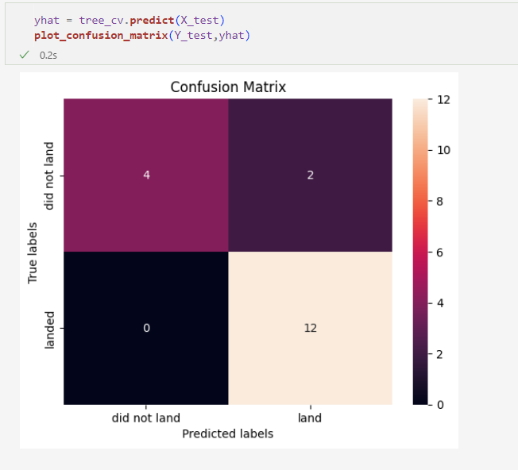
Confusion Matrix
The confusion matrix for the decision tree classifier shows that the classifier can distinguish between the different classes. The major problem is the false positives. i.e., an unsuccessful landing is marked as a successful landing by the classifier.

Slide 45
Conclusions
The larger the flight amount at a launch site, the greater the success rate at a launch site.
Launch success rate started to increase from 2013 till 2020.
Orbits ES-L1, GEO, HEO, SSO, and VLEO had the most success rate.
KSC LC-39A had the most successful launches of any site.
The Decision tree classifier is the best machine learning algorithm for this task.

Slide 46


